Slide 1
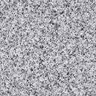
Flocculation Model
AguaClara Hydraulic Flocculation Model
Synthesized from 15+ years of laboratory research and conversations with many plant operators
Monroe Weber-Shirk
AguaClara Reach

Slide 2
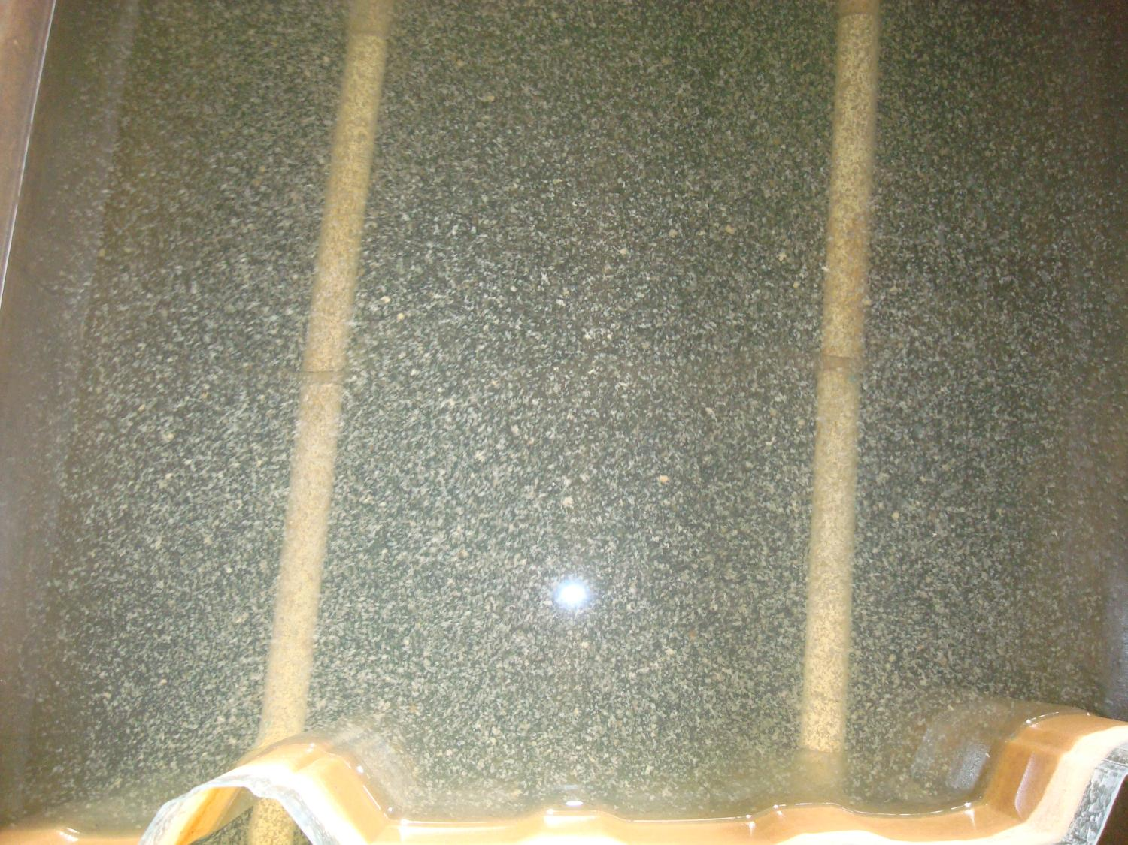

Slide 3
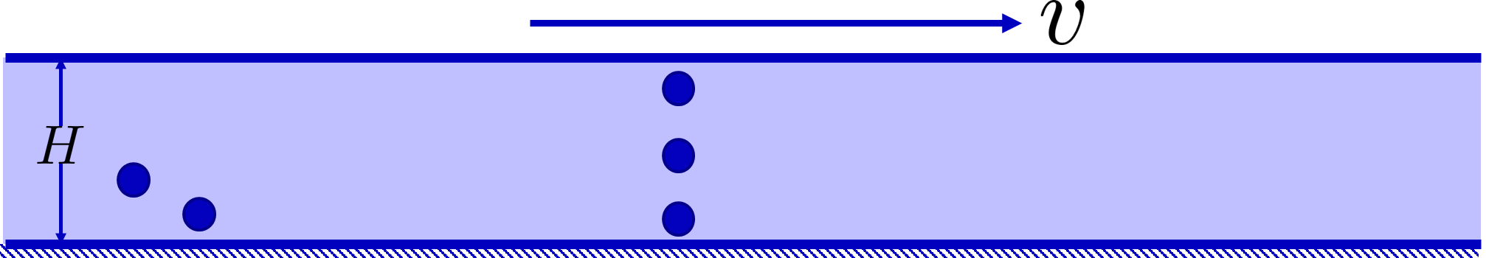
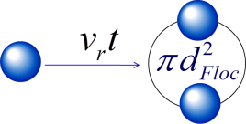
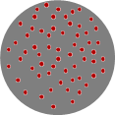
Overview
Energy cascade and creating collisions
Fractals
Collisions
Predictive model
Surface coverage

Slide 4
Energy Cascade
Origin of the energy is Mechanical energy – potential or kinetic)
Mechanical Energy is converted into turbulence
Flow expansion - deceleration
Wall shear
Turbulent kinetic energy (chaotic fluid motion – velocity) creates a cascade of eddies at smaller and smaller scales (deceleration happens at smaller and smaller scales)
Viscosity kills the tiniest eddies and converts the turbulent kinetic energy into heat

Slide 5
Viscosity kills Eddies : It takes work to deform the fluid!
Little eddy

Slide 6


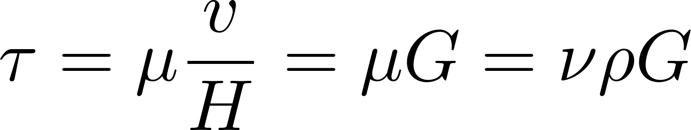
Fluids deform continuously (velocity gradient - G) given a stress (τ)
Dynamic viscosity
Kinematic viscosity
Velocity gradient

Slide 7
If I want to deform the fluid more, what should I do?
I need faster (more energetic) eddies
Hint: we call it head loss when mechanical energy is converted into heat!
What are the two mechanisms we can use to create head loss?
Wall shear
Flow expansions
Viscosity dissipates energy
Little eddy

Slide 8
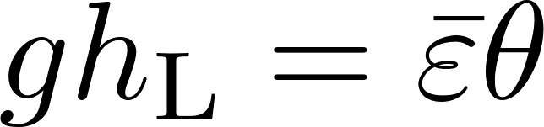
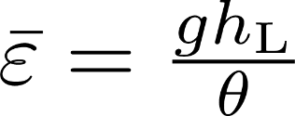
What is the Energy Dissipation Rate? (see AguaClara textbook)
Head loss is the result of dissipation of mechanical energy through viscosity to heat
Lost mechanical energy must be dissipated as heat
Pipe wall shear creates a constant energy dissipation rate in the direction of flow when averaged across the pipe
Expansions (jets) create energy dissipation that decreases rapidly with distance downstream
Where θ is the time over which the energy is dissipated

Slide 9
Units of the Energy Dissipation Rate
The turbulent eddies cause stretching and thinning of concentration gradients and “shuffle” packets of fluid
The intensity of the turbulence can be characterized by the rate at which mechanical energy is being lost to thermal energy

Slide 10
Flocculation models based on geometry and stickiness of nanoparticles can predict performance
The coagulant forms sticky nanoparticles
The bond between a coagulant nanoparticle and a clay platelet is strong
The bond between two coagulant nanoparticles might be weaker
Macromolecules of natural organic matter (NOM) cover the coagulant nanoparticles (and NOM isn’t sticky)
There is still much to learn about flocculation!

Slide 11
How do the flocs grow?

Slide 12
The size changes produced by flocculation are dramatic
How many sequential collisions are required to make a 1 mm particle starting from 1 μm particles?
How much larger in volume is the 1 mm diameter particle?
____________
1,000
,000,000 !

Slide 13
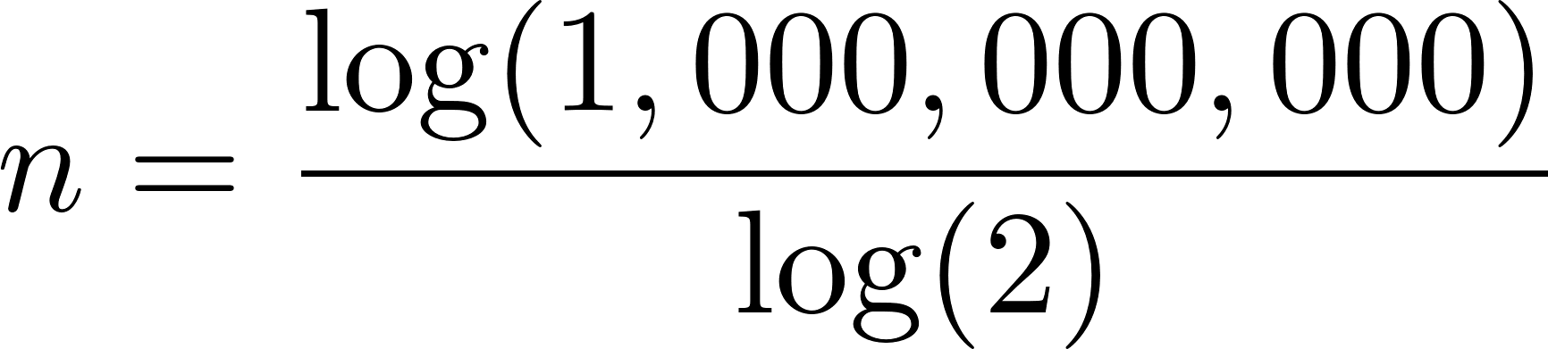
It requires many sequential doubling collisions to make a big floc
1 collision 1+1=2
2 collisions 2+2=4
3 collisions 4+4=8
4 collisions 8+8=16
Number of original particles in the floc = 2^{n}
What is n to obtain 1,000,000,000 = 2^{n}?
n=30
This assumes volume is conserved!
Notes:
Water droplets coalesce and conserve volume!

Slide 14
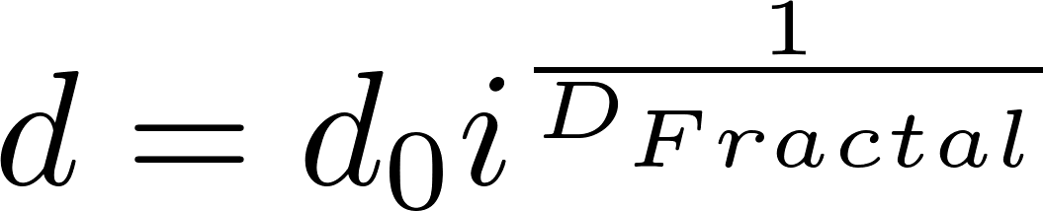
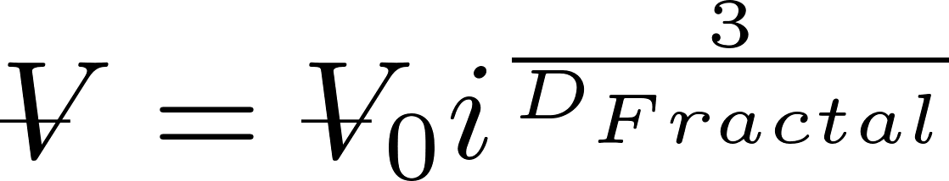
Fractals capture the idea that volume isn’t conserved
What happens to the density of a floc as it grows larger?
Floc density approaches the density of water because the floc includes water
diameter of primary particle
diameter of floc
Fractal dimension
Number of primary particles in the floc
Rain droplets growing in clouds!
3
If volume were conserved, what would D_{Fractal} be? ____
Is floc mass conserved? _____
No!

Slide 15
Fractal Geometry
Fractal geometry explains the changes in floc density and sedimentation velocity as a function of floc size
The fractal dimension of flocs is approximately 2.1
Further research to quantify the fractal dimension in flocculation (and in floc blankets) is needed
Number of primary particles in the floc
Meakin, P. (1988). Fractal Aggregates. Advances in Colloid and Interface Science, 28 (1988), 249-331.
Notes:
Adachi Wat. Res. Vol. 31, No. 3, pp. 449~54, 1997

Slide 16
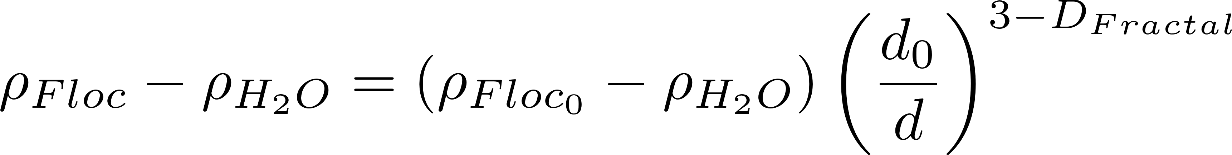
Buoyant Density of Flocs
Will these flocs settle faster than the primary particles?
Notes:
Here we assume that the primary particle (clay plus coagulant) is 1 micrometer in diameter.
The assumption is that we are starting with clay at 2650 kg/m^3.

Slide 17
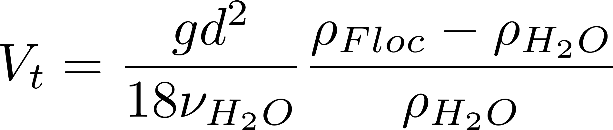
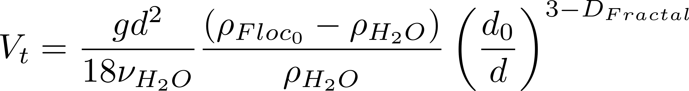
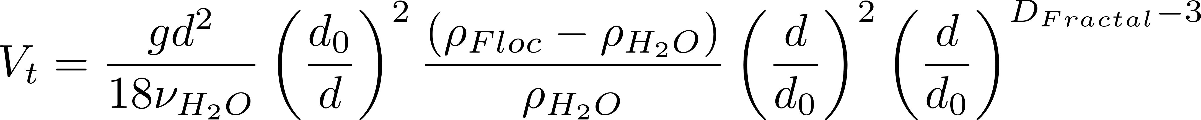
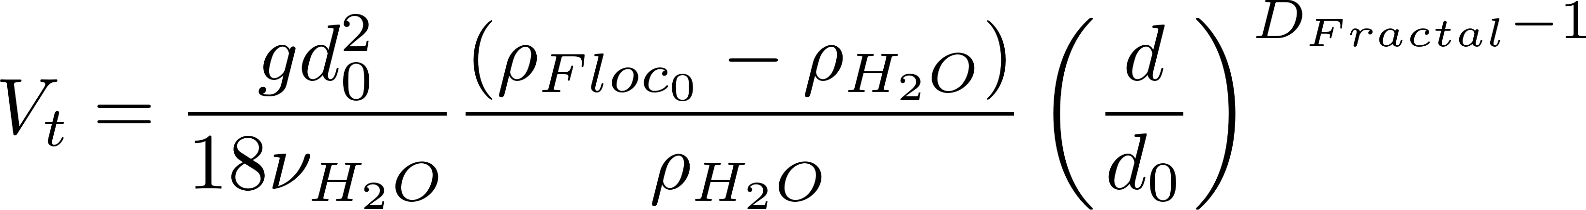
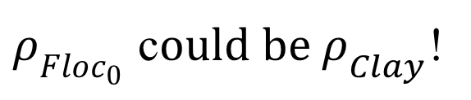
Fractal Terminal Velocity Equations
Buoyant density
Viscous flow terminal velocity
Algebra!
$ρ_{Floc_{0}}$ c$ould be ρ_{Clay}$!

Slide 18
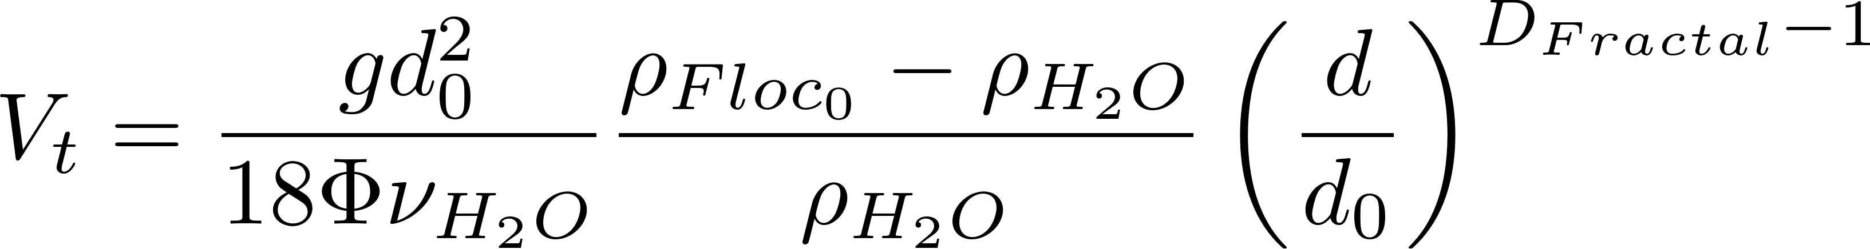
Floc Terminal Velocity
Laminar flow
Upflow velocity for floc blankets
Capture velocity for AguaClara plate settlers
Why flocculation is necessary!
1 μm
D_{Fractal} = 2.3 and d₀ = 1 μm
shape factor for drag on flocs
The model takes into account the changing density of flocs
Notes:
The shape factor adjusts the coefficient of drag for non spherical geometry and according to Tambo has a value of 45/24 for flocs (Tambo et al., 1979). This value is probably not yet well characterized. In any case it is expected to be order 1 because it is a correction to the drag coefficient due to shape.
All fractal dimensions greater than one are expected to increase the terminal velocity as the floc diameter increases.
Both floc blanket upflow velocity and plate settler capture velocity are AguaClara current design values, but are not optimized.

Slide 19
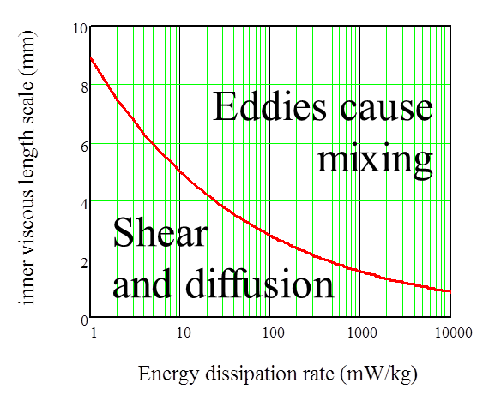
Collision Model of the Flocculation Process
The relative velocity between flocs is set by viscous shear because their separation distance is less than the inner viscous scale
Inner viscous scale is where viscosity kills eddies!
The time required per collision is a function of the relative velocity between flocs, the average separation distance between flocs, and the floc size
In the next slides we will explore how to characterize collision time for flocs
We will assume that collisions occur between similar sized flocs. There is some evidence that flocs of very different diameters don’t collide.

Slide 20
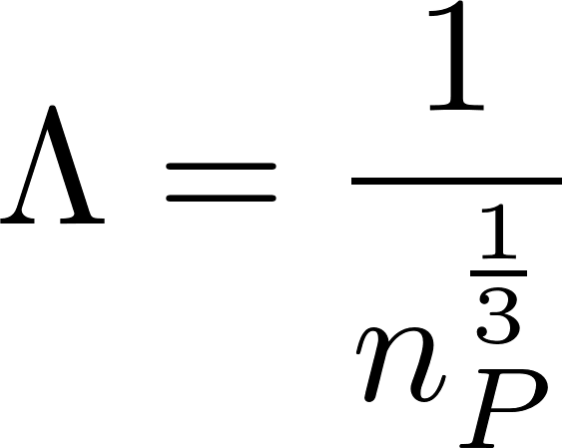
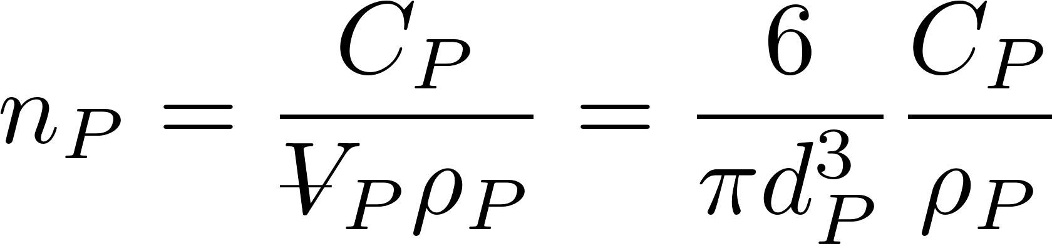
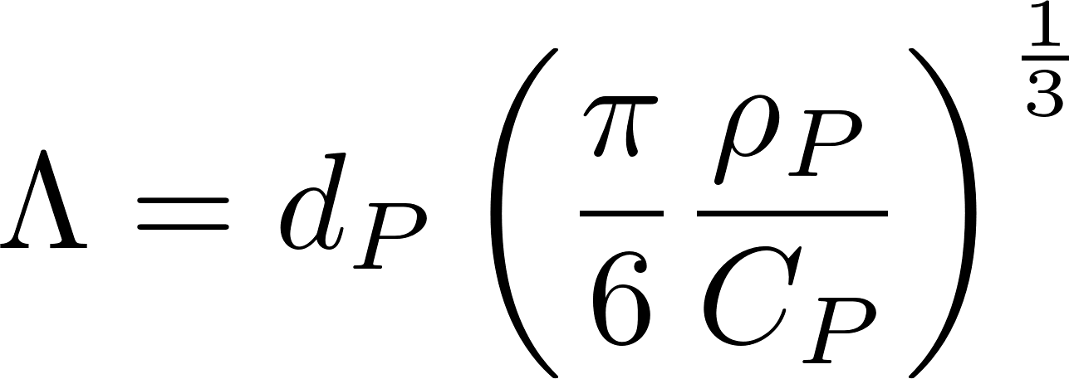
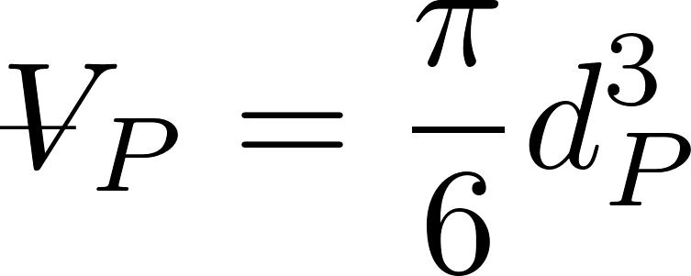
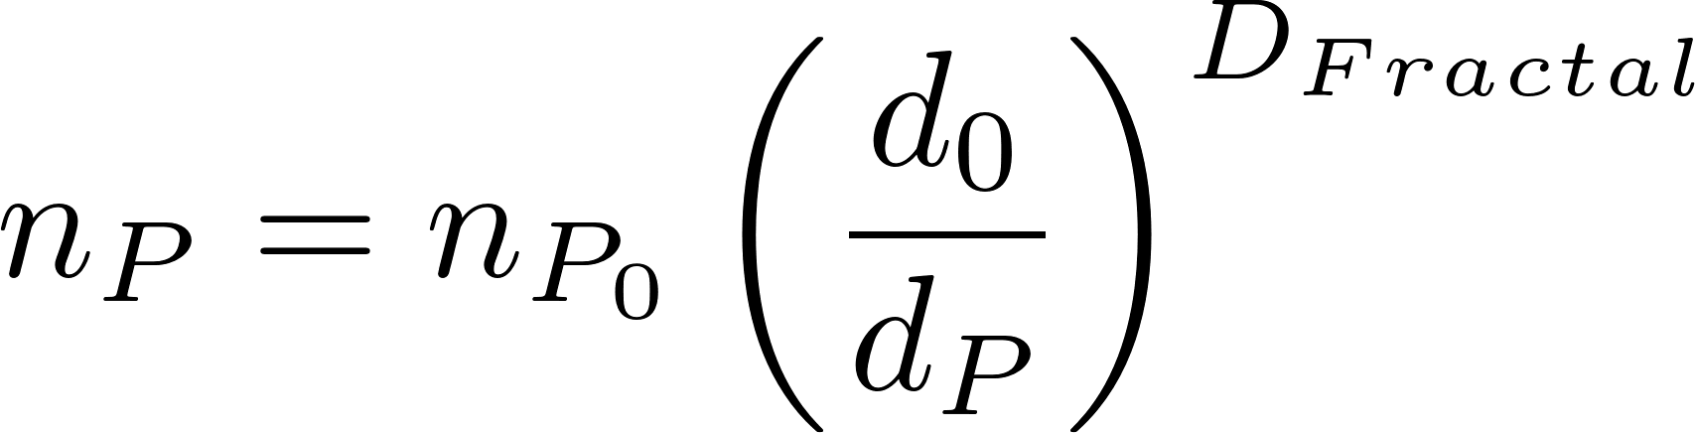
Average distance between particles is the cube root of the volume occupied (Λ)
The average volume of water “occupied” by a particle!
Need to know number of particles per volume (n_{P})
The number of flocs decreases as the flocs grow in size

Slide 21
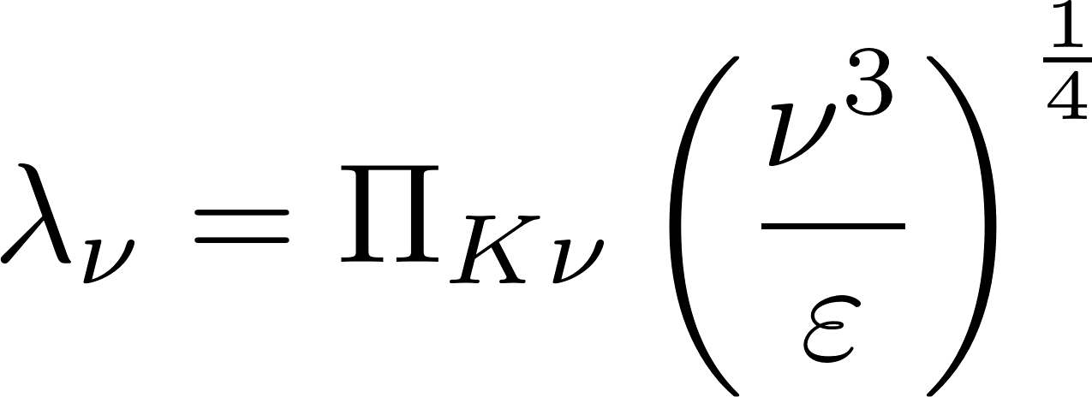
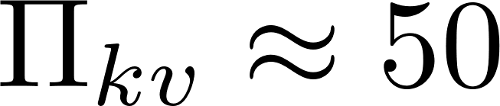
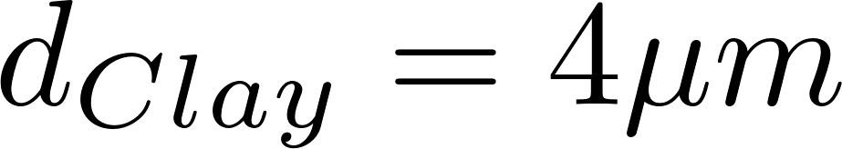
Particle collisions in flocculators (and rapid mix units!) are dominated by viscous shear
Kinematic viscosity
Inner viscous scale
Energy dissipation rate
In drinking water treatment plants, particle separation distances are much less than the viscous length scale
It took us years to figure this out!
inertial
viscous
Notes:
http://dimotakis.caltech.edu/pdf/Dimotakis_JFM2000.pdf (see equation 20 for factor of 50)
Assume clay size is 4 micron.
Rapid mix exploration.xmcd

Slide 22
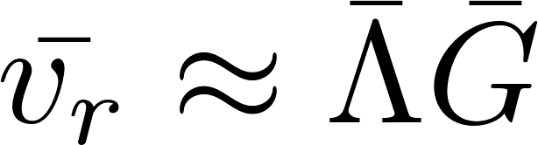
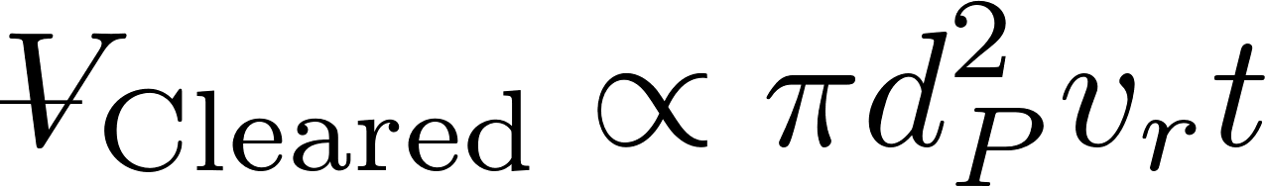
Hypothesis: Relative velocity scales with separation distance
Target
Notes:
Why is the path chaotic?
What is the relative velocity?
How far does the particle need to travel before there is a collision?

Slide 23
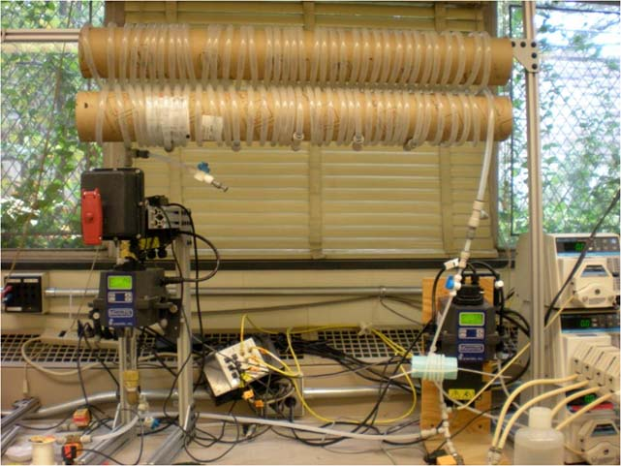
Coiled Tube Flocculation Residual Turbidity Analyzer
Dr. Karen Swetland Dissertation research
Notes:
Here we plotted the residual turbidity, the turbidity of the water after settling, against the coagulant dose. We noticed that when we used a log-log plot, there was a linear trend in the data. So we explored further.

Slide 24
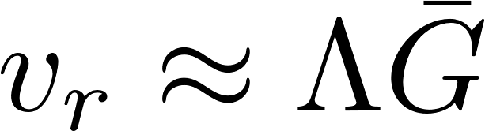
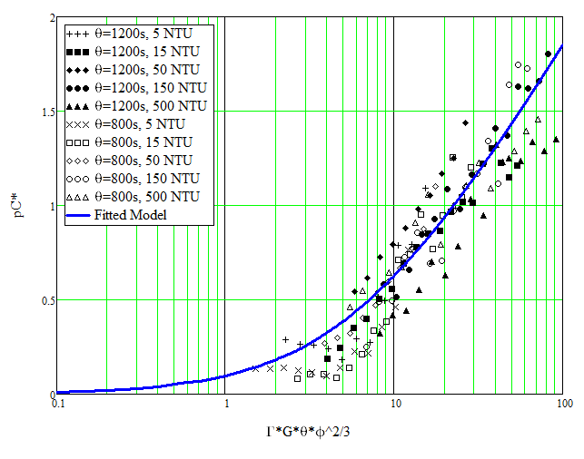
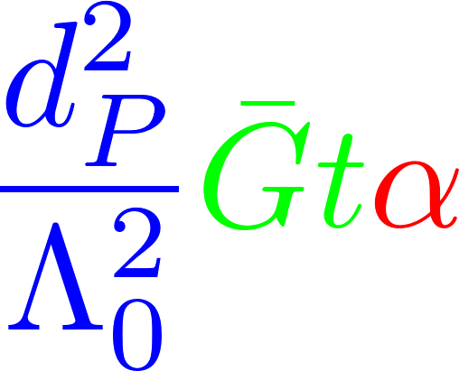
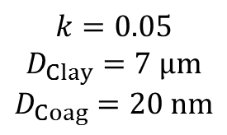
Separation Distance Scaling
$$k=0.05$$
$$D_{Clay}=7 μm$$
$$D_{Coag}=20 nm$$
The first demonstration that it is possible to create a dimensionally correct description of flocculation!

Slide 25
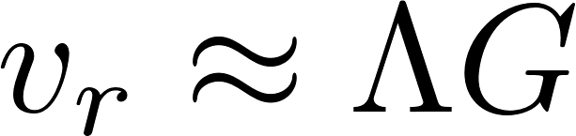
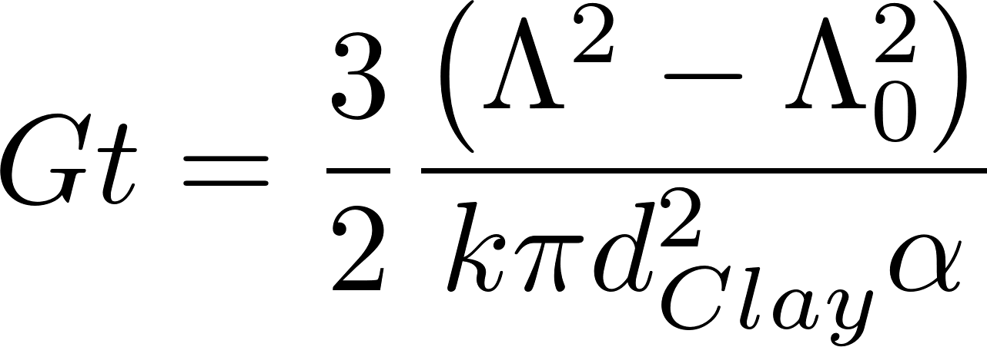
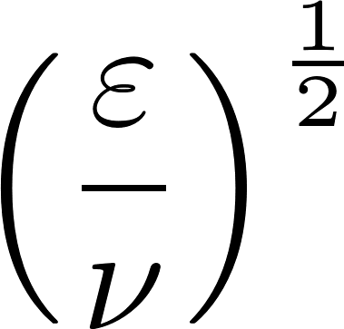
Floc model for viscous dominated collisions
Final particle spacing
Initial particle spacing
Flocculation time
Velocity gradient
Rate constant (model fitting parameter) : includes info on size distribution
Attachment efficiency: A function of fractional surface coverage of particle by coagulant
Particle diameter
Dimensionless concentration of particles that don’t settle

Slide 26
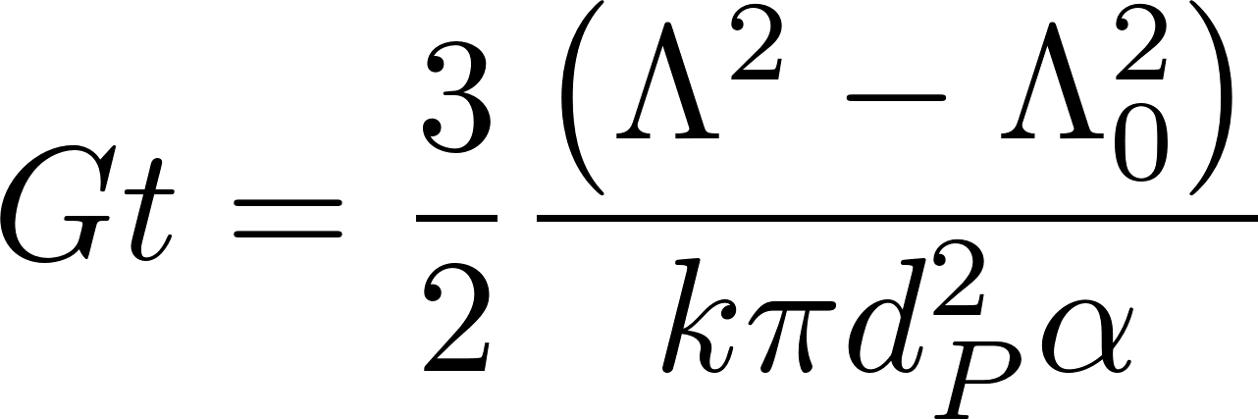
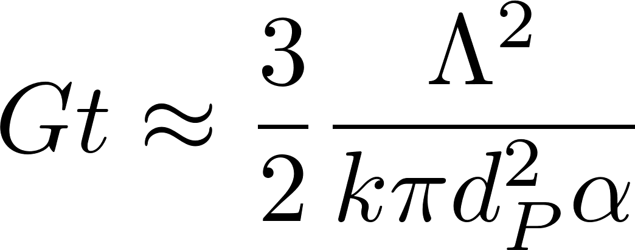
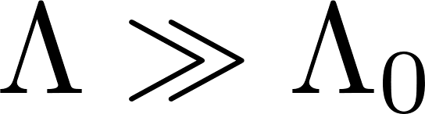
Model predictions?
Flocculator can be designed for target settled water turbidity which is almost independent of the raw water turbidity!
Coagulant dose determines the attachment efficiency (and flocculation begins at low dosages)
This model ONLY PREDICTS the separation distance of non-aggregated primary particles

Slide 27
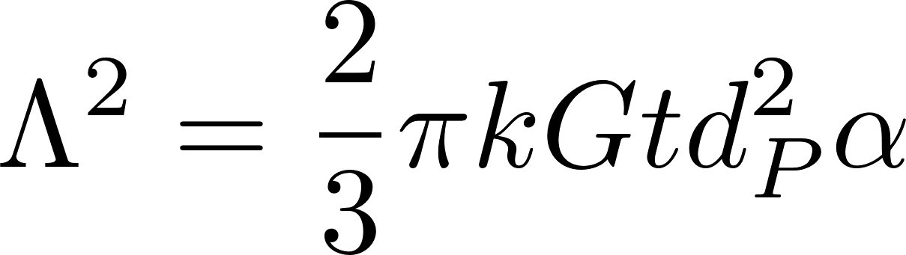
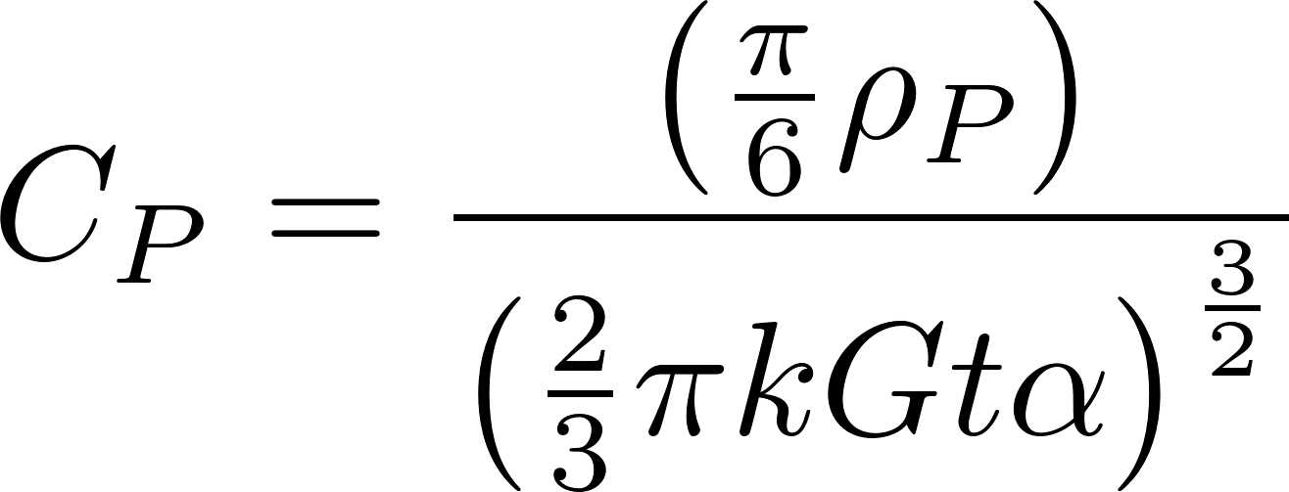
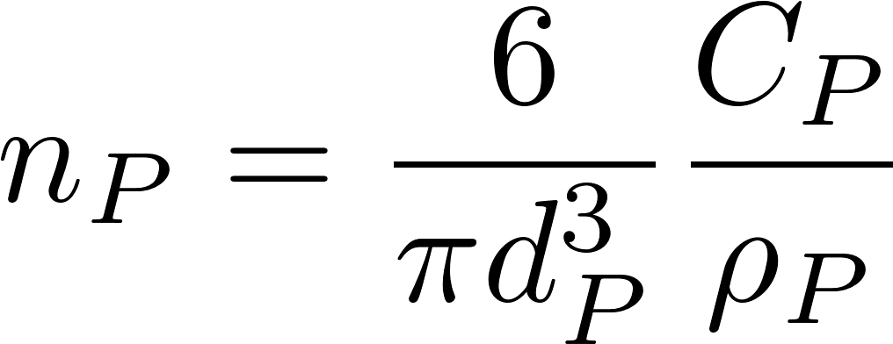
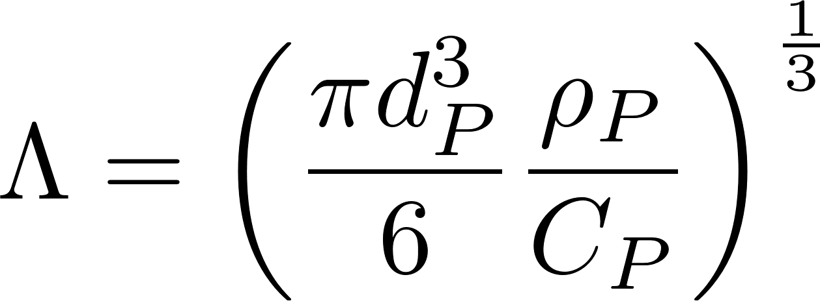
Non-flocculated Primary particle concentration
We can convert the particle spacing into a concentration
k determined by William Pennock to have a value of about 0.03.
Clay diameter assumed to be 7 micrometer
68 NTU = 100 mg/L Kaolin clay
Coagulant nanoparticles = 90 nm in diameter

Slide 28
Surface Water often has Natural Organic Matter (NOM)
Coagulant nanoparticle
Natural Organic Matter (NOM)

Slide 29
Pre-hydrolyzed coagulant precipitates as stable (and sticky) Al₁₃ clusters (nano particles)
clay

Slide 30
Coagulant precipitate nano particles are sticky!
Coagulant nano particles (sticky)
Clay (not sticky)
Dissolved organic matter (not sticky)
Notes:
Inner sphere bonds

Slide 31
Natural organic matter adsorbs to the coagulant nanoparticles and coats the sticky surfaces
Observations and a Geometric Explanation of Effects of Humic Acid on Flocculation Y Du, WH Pennock, ML Weber-Shirk, LW Lion Environmental Engineering Science 36 (5), 614-622 (2019)

Slide 32
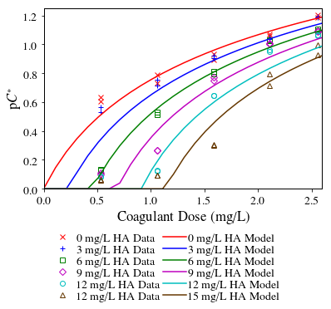
Dissolved organic matter impedes flocculation by covering the coagulant nanoparticles
Humic Acid
(not sticky)
90% efficiency
Coagulant nanoparticles
(sticky)
-log of fraction remaining
Increasing humic acid
Clay (or pathogen!)
(not sticky)
Notes:
No improvement to turbidity until all of the humic acid has attached to coagulant nanoparticles and there are clean surfaces of coagulant left over.

Slide 33

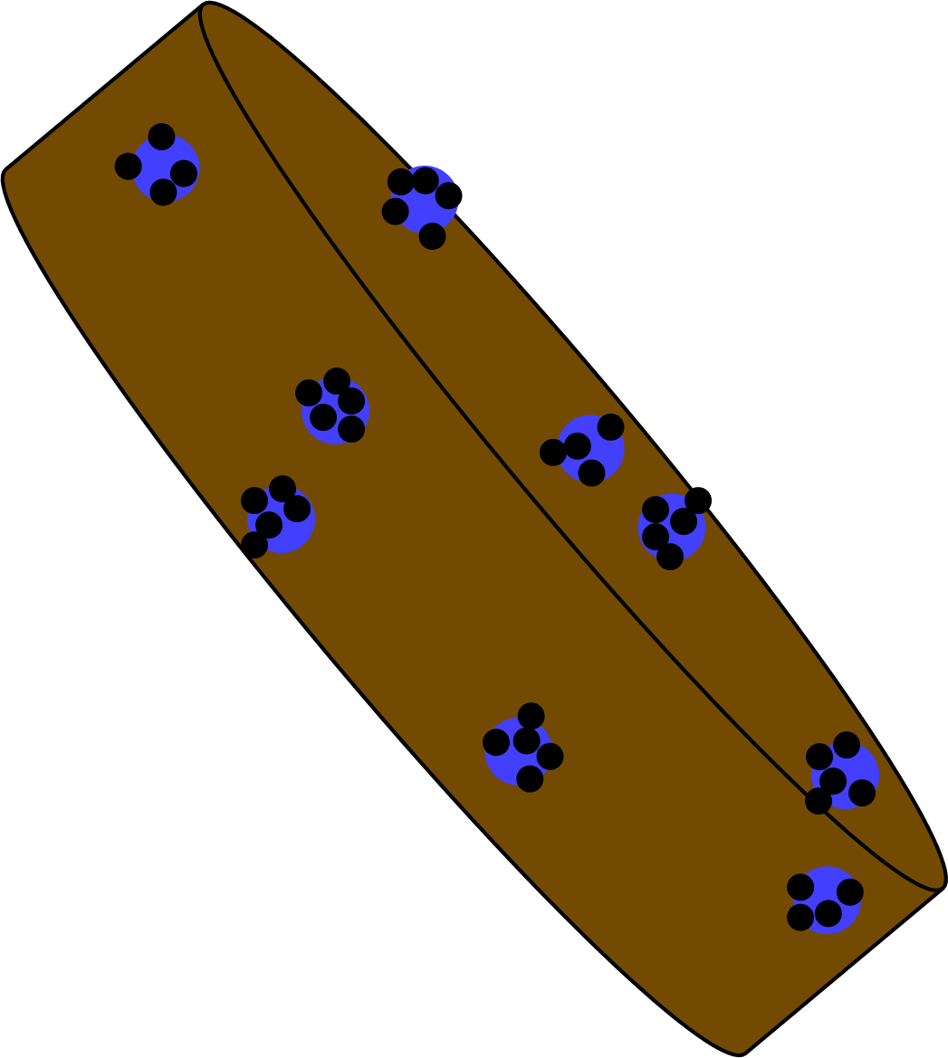
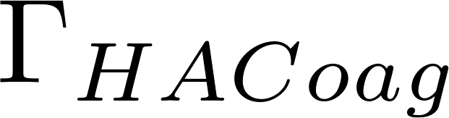
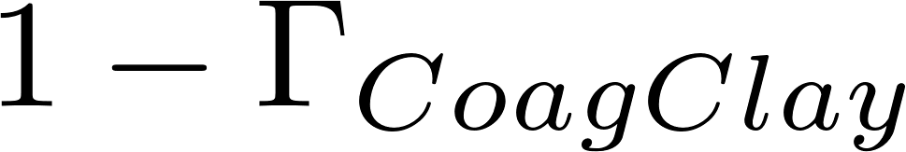

Calculating attachment efficiency
Fraction of clay surface area coated by coagulant (this includes coagulant that is coated with humic acid)
Fraction of coagulant surface area coated by humic acid
Fraction of clay surface area that isn’t coated by anything
Fraction of clay surface area that is coated by clean coagulant
Fraction of clay surface area that is coated by coagulant that is coated by humic acid

Slide 34
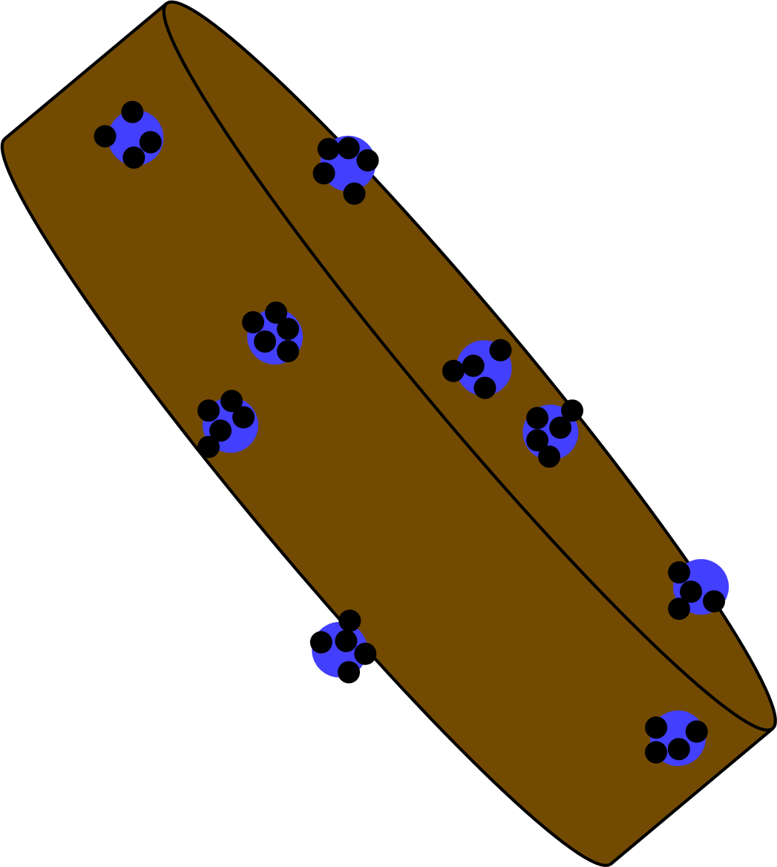
There are 3 possible initial points of contact that can lead to attachment
The probability of a clay surface colliding with a PACl surface is equal to twice the probability that the first surface is clay and the second surface is the PACl surface of a PACl-HA nanoaggregate
The probability of a PACl surface colliding with a PACl surface
The probability of a PACl surface colliding with a HA surface

Slide 35
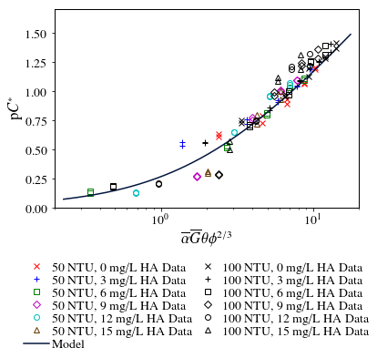
Settled water turbidity can be predicted!
This is remarkable in that the model captures both the effects of inorganic particles and dissolved organic matter
The model complexity is calculating the probability of a collision that will involve a sticky surface
90% removal
-log of fraction remaining

Slide 36
The flocculation model is far from complete
Doesn’t predict decreasing performance at high coagulant dosages
Possible that coagulant-coagulant bonds are weaker than coagulant-clay bonds and we don’t yet have that effect in the model
Floc density decreases as coagulant dose is increased and it is likely that flocs with excess coagulant have lower terminal velocities
Doesn’t describe floc formation when the dissolved organics concentration is so high that bonds are significant
Doesn’t describe effects of sedimentation tank design (we are making progress on this!)

Slide 37

4 major assumptions of the AguaClara Hydraulic Flocculation Model
Long range transport velocity to a collision scales with the average separation distance of the particles
Relative velocities between particles are dominated by viscous shear (not inertia)
Separation distance is smaller than inner viscous scale
In fluid shear only similarly sized particles can collide
Plug flow!

Slide 38






What does Gt mean?
y
y
velocity
Displacement in time t
$$v_{r}$$
$$Λ$$
u
x
$$L_{Deformation}$$
Definition of velocity gradient
Find relative velocity between flocs separated by distance $Λ$
The relative distance traveled due to fluid deformation is proportional to time
A Gt of 1 means that the particles have a relative displacement equal to their separation distance

Slide 39
Fractal Flocculation Conclusions
It is difficult to flocculate to a low residual turbidity because the time between effective collisions increases as the number of primary particles decreases
Primary particles can’t attach to flocs in shear flow because of the boundary layer of fluid around the floc
Our goal is to reduce the concentration of the un-flocculated primary particles!

